Slide 1
Positive Behaviour Supports
Direct Observation

Slide 2

Data-driven decision making
better understand the purpose and context of specific behaviours
guide the development and implementation of behaviour support plans
know when a behavior is improving (the plan is effective)

Slide 3
Functional Behaviour Assessment Steps
Decide if a intervention is warranted
Develop a personal profile
Define the target behaviour
Conduct a functional behaviour interview
Conduct direct observations
Use setting events checklist
Form hypothesis
Design an support plan (prevent, teach and respond)
Evaluate plan

Slide 4

Direct observation
To get a representative sample of the behaviour and related factors
(A-B-C)
To examine environmental considerations
Select an appropriate method
Use practical and efficient methods
Record for 2-5 days or 20-30 occurrences

Slide 5

Direct Observation
Ensure all recorders are clear on the target behaviour and recording method
Record the target behaviour immediately as it occurs
May transfer the data to a graph

Slide 6

Direct Observation
Typical methods
Frequency
Duration
ABC charts
Scatter plots
Event recording
Functional Assessment Observation

Slide 7
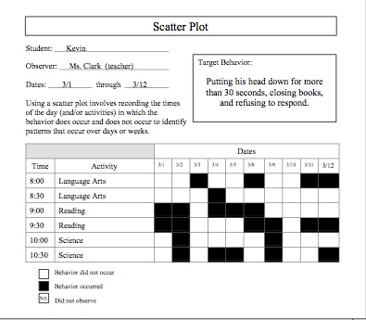
Scatter Plot

Slide 8
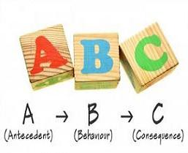
ABC Recording
Looks at the A (antecedent) in relation to the behaviour (B) and the consequence (C) in relation to the behaviour
Works well when students have less than 8 occurrences / day
Records using narrative comments

Slide 9
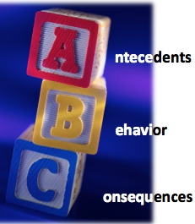
ABC Recording
Helps ascertain the function of the behaviour
Need to conduct for several occurrences
Highlights areas for proactive support and what educators need to do differently (C) - adult responses often maintain an inappropriate behaviour and therefore an educator may need to learn different ways of responding

Slide 10
